Slide 1
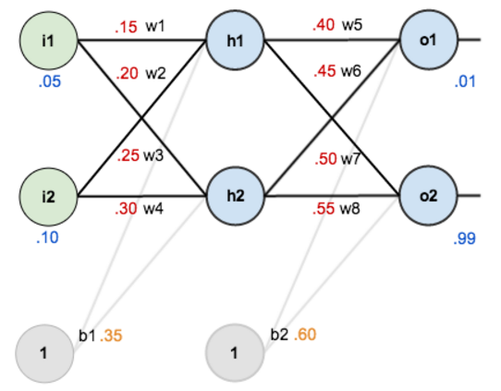
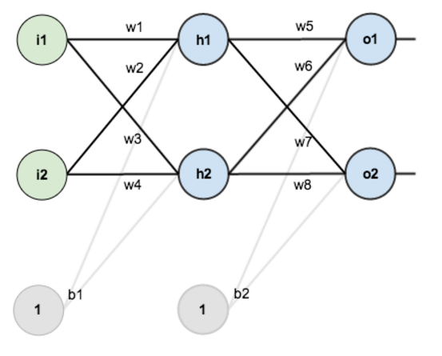
Let’s Clarify
With two feature input , weights and bias values

Slide 2
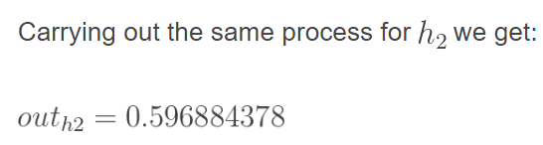
Forward Pass – Hidden Layer
net_{h1} = w₁ * i₁ + w₂ * i₂ + b₁ * 1
net_{h1} = 0.15 * 0.05 + 0.2 * 0.1 + 0.32 * 1 = 0.3775
Passing net_{h1 through sigmoid function,} gives the output of h1, out_{h1}
Out(h2)=?
net_{h1}
out_{h1}

Slide 3
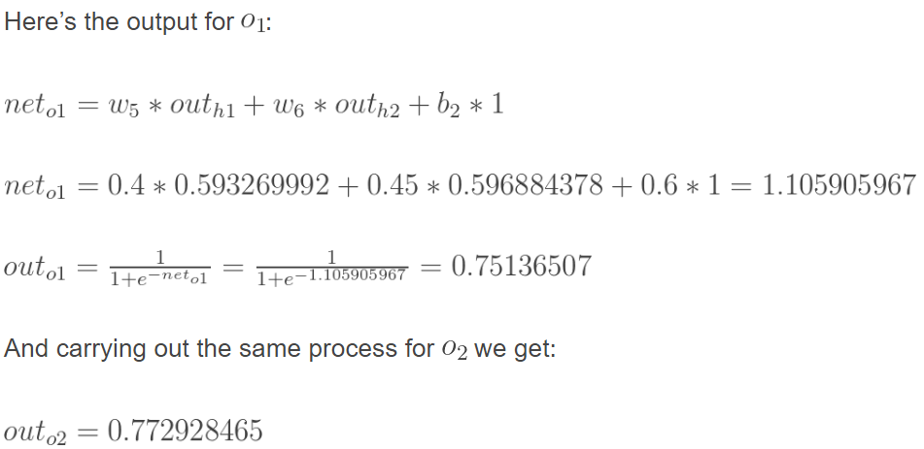
Forward Pass – Output Layer
net_{o1}
out_{o1}

Slide 4


Calculating the total Error
Calculate the total error for each output neuron using the squared error function and sum them to get the total error:
Note: The ½ is included so that exponent is cancelled when we differentiate later on. The result is eventually multiplied by a learning rate anyway so it doesn’t matter that we introduce a constant here
E(o2)=?

Slide 5
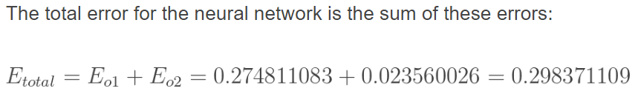
Total Error

Slide 6
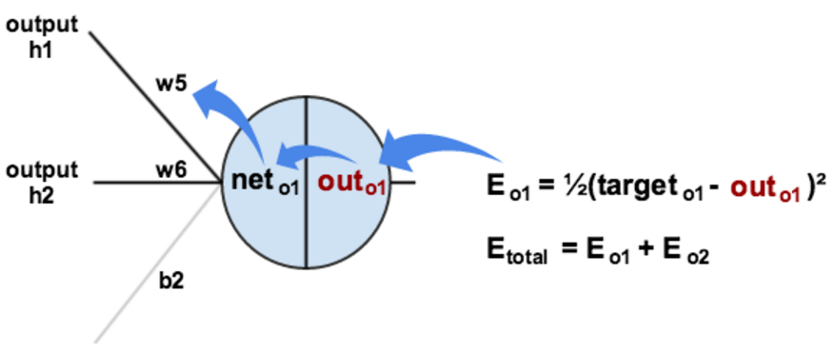

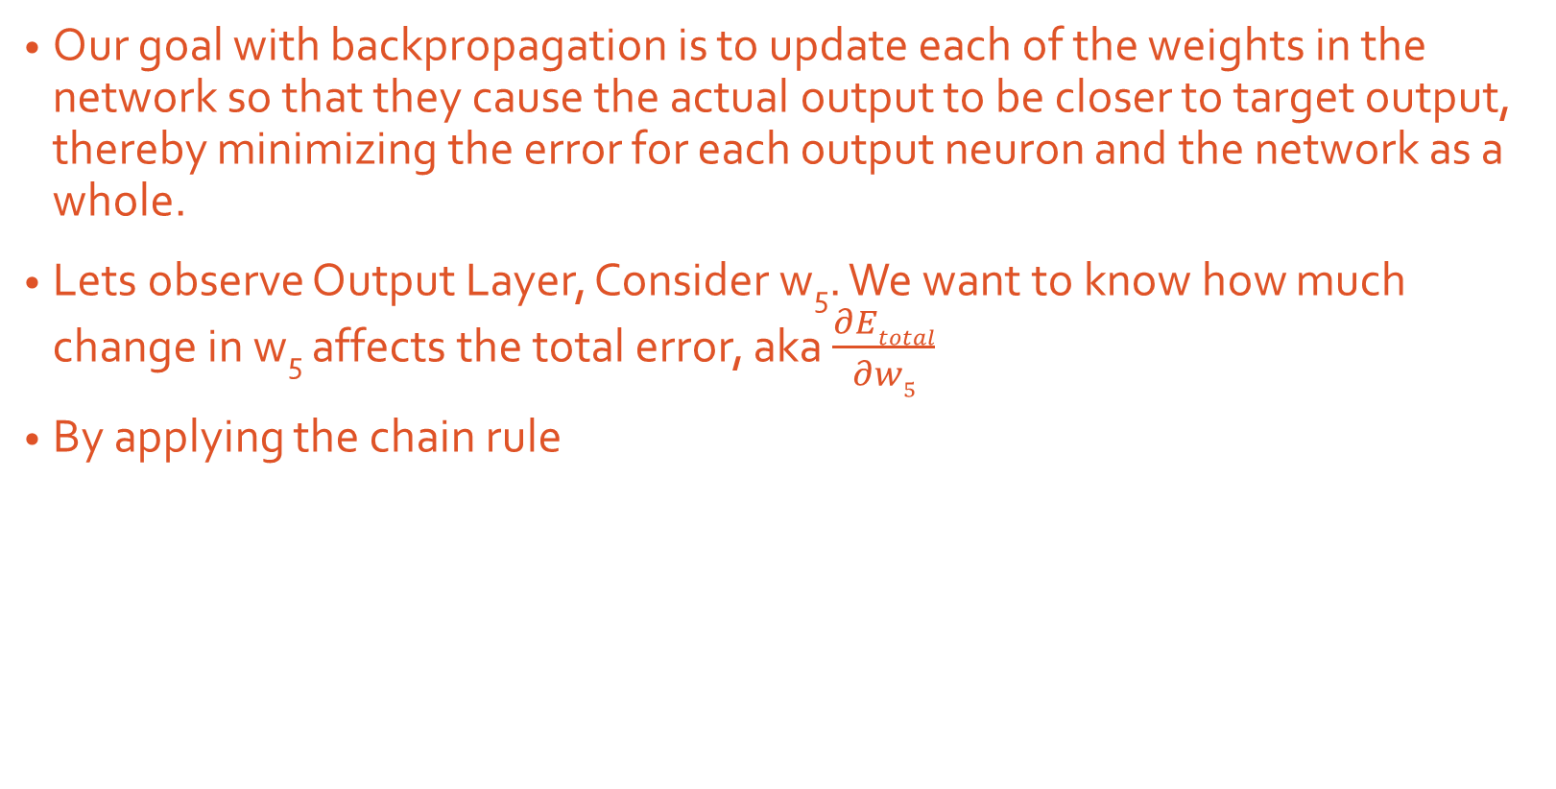
Backward Pass- Actual Learning
Our goal with backpropagation is to update each of the weights in the network so that they cause the actual output to be closer to target output, thereby minimizing the error for each output neuron and the network as a whole.
Lets observe Output Layer, Consider w₅. We want to know how much change in w₅ affects the total error, aka $\frac{∂Etotal}{∂w5}$
By applying the chain rule

Slide 8

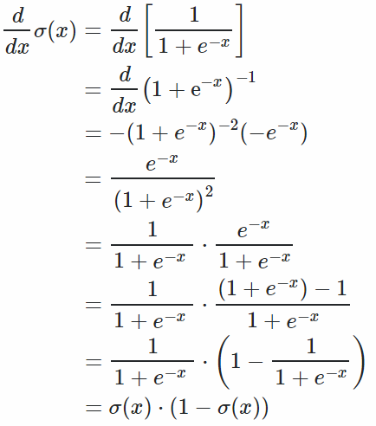
Derivative of sigmoid function

Slide 9
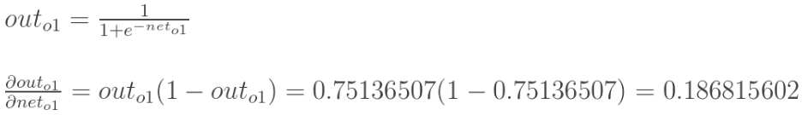

Slide 10

Also called as Delta Rule

Slide 11




Learning and Learning Rate
To decrease the error, we then subtract this value from the current weight (optionally multiplied by some learning rate, eta, which we’ll set to 0.5):

Slide 12

Hidden Layer
We need to update w1, w2, w3, w4. Hence we need to figure out,

Slide 13
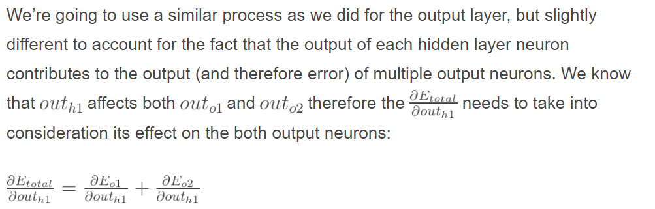

Slide 14
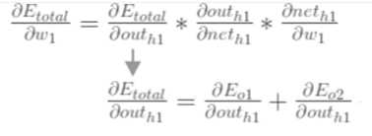
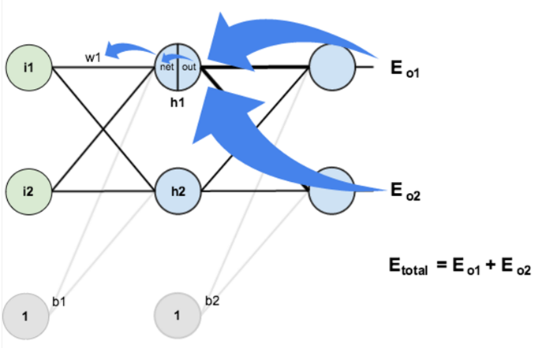
Visually,

Slide 15
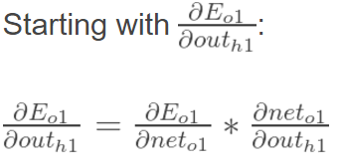



So,

Slide 16






Slide 17






Putting it all together,

Slide 18
Finally,
We’ve updated all of our weights! When we fed forward the 0.05 and 0.1 inputs originally, the error on the network was 0.298371109.
After this first round of backpropagation, the total error is now down to 0.291027924.
It might not seem like much, but after repeating this process 10,000 times, for example, the error plummets to 0.000035085.
At this point, when we feed forward 0.05 and 0.1, the two outputs neurons generate 0.015912196 (vs 0.01 target) and 0.984065734 (vs 0.99 target).

Slide 19
Neurons in hidden layer
There are many rule-of-thumb methods for determining the correct number of neurons to use in the hidden layers, such as the following:
The number of hidden neurons should be between the size of the input layer and the size of the output layer.
The number of hidden neurons should be 2/3 the size of the input layer, plus the size of the output layer.
The number of hidden neurons should be less than twice the size of the input layer.

Slide 20
References
https://mattmazur.com/2015/03/17/a-step-by-step-backpropagation-example/

Slide 21
MLPClassifier
class sklearn.neural_network.MLPClassifier(
hidden_layer_sizes=(100, ) (5, 2) The i^{th} element represents the number of neurons in the ith hidden layer.
activation=Activation function for the hidden layer.
activation : {‘identity’, ‘logistic’, ‘tanh’, ‘relu’}, default ‘relu’
‘identity’, no-op activation, useful to implement linear bottleneck, returns f(x) = x
‘logistic’, the logistic sigmoid function, returns f(x) = 1 / (1 + exp(-x)).
‘tanh’, the hyperbolic tan function, returns f(x) = tanh(x).

Slide 22
solver : {‘lbfgs’, ‘sgd’, ‘adam’}, default ‘adam’
The solver for weight optimization.
‘lbfgs’ is an optimizer in the family of quasi-Newton methods.
‘sgd’ refers to stochastic gradient descent.
‘adam’ refers to a stochastic gradient-based optimizer proposed by Kingma, Diederik, and Jimmy Ba
Note: The default solver ‘adam’ works pretty well on relatively large datasets (with thousands of training samples or more) in terms of both training time and validation score. For small datasets, however, ‘lbfgs’ can converge faster and perform better.

Slide 23
alpha=0.0001,
MLPClassifier use parameter alpha for regularization (L2 regularization) term which helps in avoiding overfitting by penalizing weights with large magnitudes.
max_iter : int, optional, default 200
Maximum number of iterations. The solver iterates until convergence (determined by ‘tol’) or this number of iterations.
tol : float, optional, default 1e-4
Tolerance for the optimization. When the loss or score is not improving by at least tol for two consecutive iterations, convergence is considered to be reached and training stops.

Slide 24
learning_rate_init : double, optional, default 0.001
The initial learning rate used. It controls the step-size in updating the weights. Only used when solver=’sgd’ or ‘adam’.

Slide 25
Regularization
One method of combating overfitting is called regularization.
Regularization modifies the objective function that we minimize by adding additional terms that penalize large weights.
https://missinglink.ai/guides/neural-network-concepts/7-types-neural-network-activation-functions-right/

Slide 26
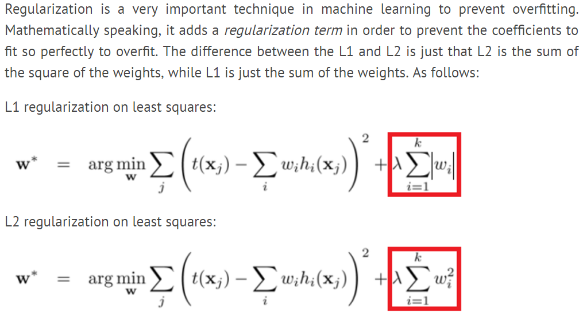
Lambda is weight decay parameter

